Slide 1
Crowdsourcing-Twitter-NER
Jiawei zhang @rivuletzhang
Jianqiao Liu @trackpoiNt10
Course project
taught by Prof. Alex quinn
Purdue University

Slide 2
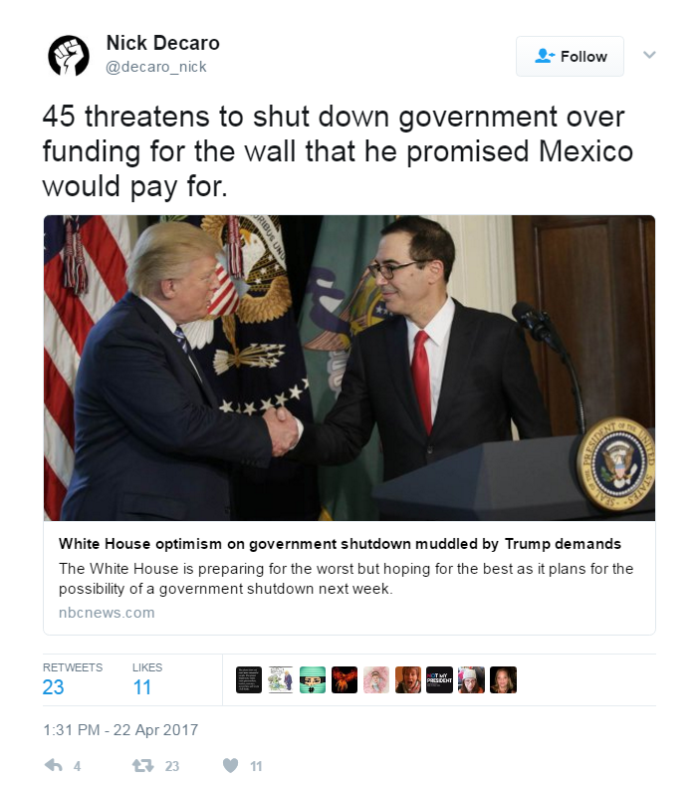
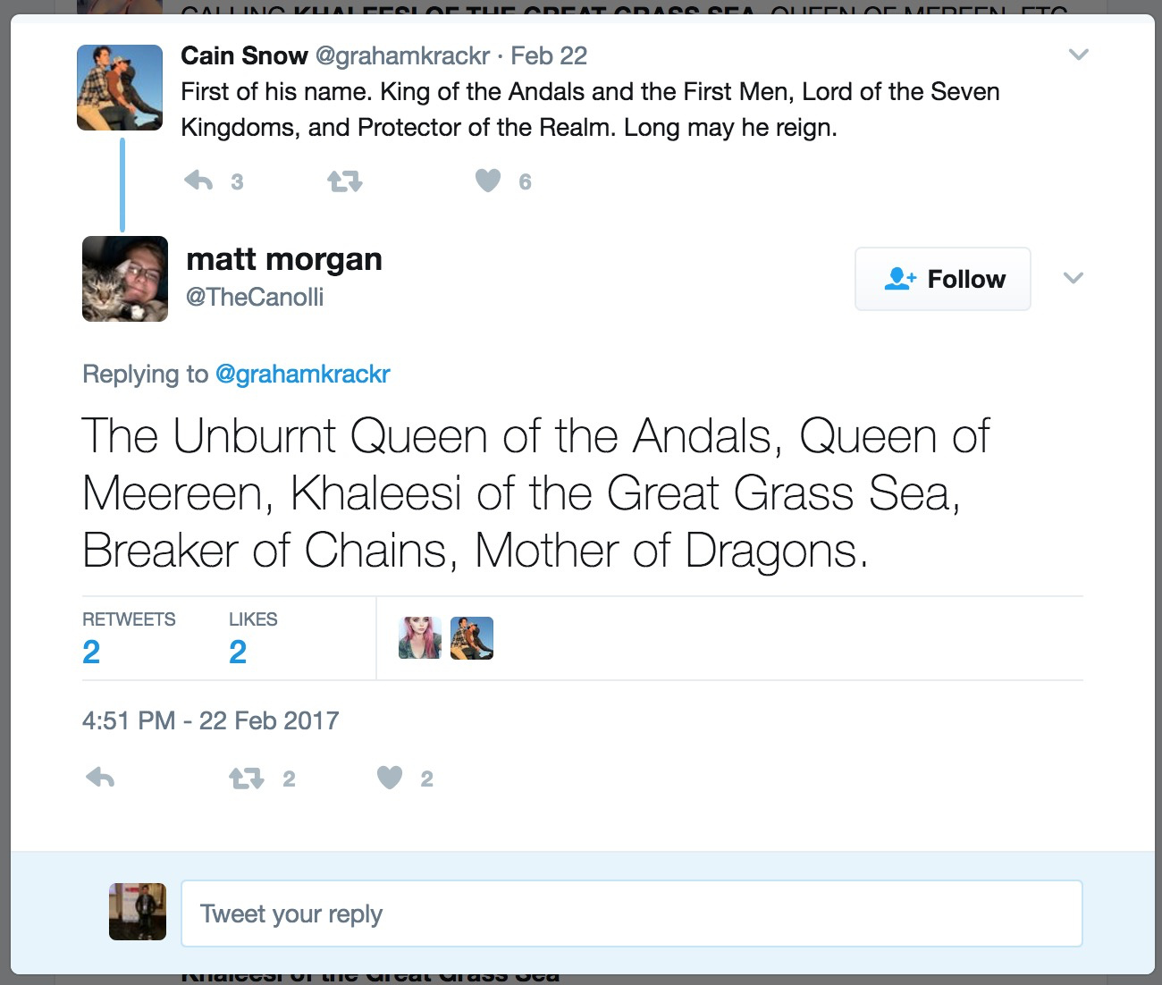
Obsure words in social networks
Sensitivity consideration
Fun / lazy use
Culture connotation
New born words
Notes:
Here’s an illustrative figure showing edges connecting communicating services which are arranged along the circumference of the circle. Over 1000+ services run atop our platform.
One service, the Twitter front-end reverse proxy, called TFE, is highlighted here and we show the set of services that it might talk for servicing a request to create a tweet.
A typical request might flow (not necessarily sequentially) through a set of other services before a response can be generated. The critical path for such a request may hit a dozen or so services, so that to keep tail latencies low, each service must perform efficiently.

Slide 3
Crowdsourcing-Twitter-NER
Our goal:
Help people with no background knowledge
Tag entities for machine learning algorithms
Tweets
Crowd
Knowledge
Database
Crowd
Update
Knowledge
Machine
Algorithm

